Slide 1

Under regional warming and rising atmospheric moisture. How extra moisture translates into extreme precipitation events (2006-2080).
EART60702 Earth and Environmental Data Science
Group 2 Presentation
24 February 2026
Xinqi Xie Qianhao Li Xinhao Zhou Emmanuel Julius.

Slide 2
Introduction
Research question:
Under warming with rising atmospheric moisture, how does this translate into extreme precipitation changes?
Specific objectives;
To investigate long-term trends in temperature, specific humidity, and precipitation.
To evaluate the linear correlations between parameters.
To quantify changes in the extreme rainfall frequency and intensity events and assess their implications.
Parameters of choice;
Temperature (TREFMXAV), precipitation rate (PSRN), and specific humidity (TREFHT)
Analyses conducted;
Descriptive, time-series trend, correlation, variability, and extreme value analyses.

Slide 3
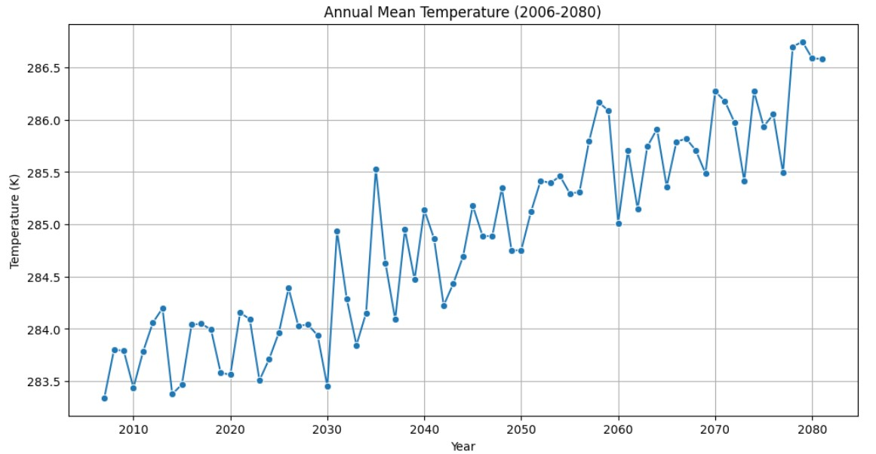
Section 1: Time - Series Trend Analysis
Temperature Trend (2006 -2080)
Key Trend: Significant and consistent warming path throughout the 21st century.
Observation: Average temperatures rise from approximately 283.5K to over 286.5K.
Implication: Provides the thermal energy required to increase atmospheric water-holding capacity.

Slide 4
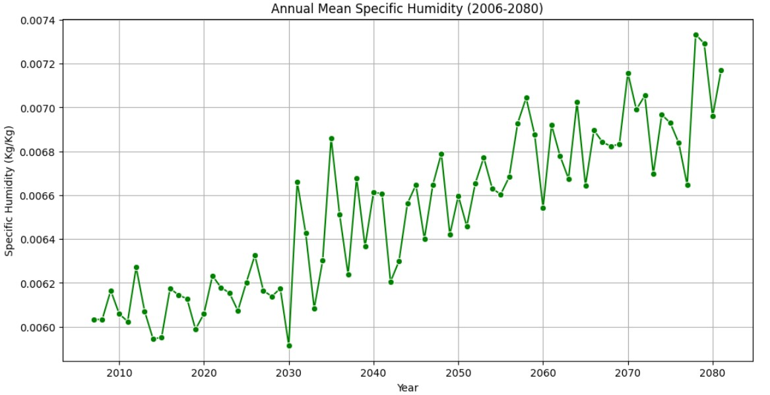
Section 1: Time - Series Trend Analysis
Specific Humidity Trend (2006 -2080)
Key Trend: Clear upward trend in atmospheric moisture levels, closely following the temperature rise.
Correlation: Higher temperatures lead to increased evaporation and moisture retention.
Data Point: Specific humidity increases from ~0.0060 Kg/Kg to over 0.0072 Kg/Kg.

Slide 5
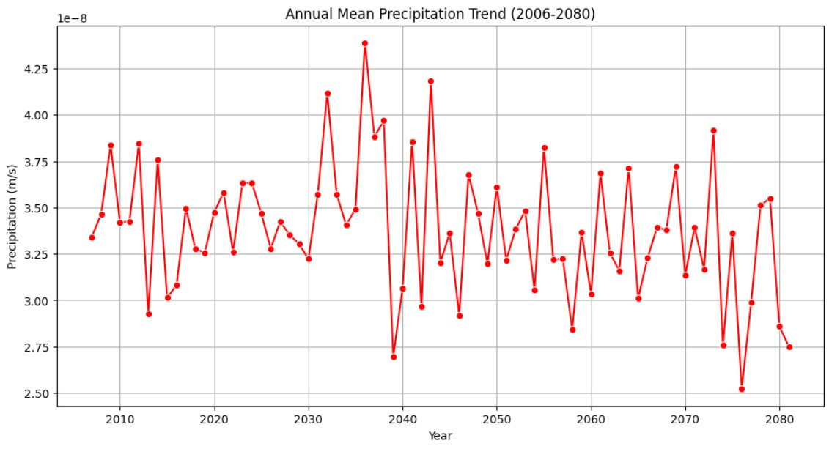
Section 1: Time - Series Trend Analysis
Precipitation Trend (2006 -2080)
Key Trend: No clear linear long-term increase in mean annual precipitation.
Highly Unpredictable: Significant changes from one year to the next (frequent ups and downs)
Conclusion: Regional warming does not lead to a matching increase in average rainfall.

Slide 6
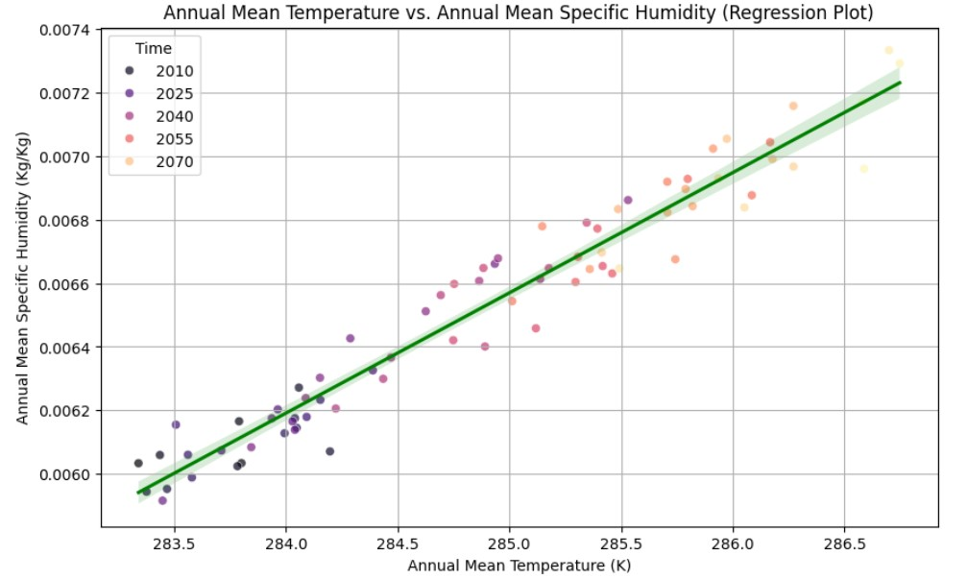
Section 2: Correlation & Statistical Analysis
Temperature vs. Specific Humidity
Statistical Result: Strong positive correlation (R=0.97).
Scientific Basis: Confirms the physical relationship where warmer air holds more water vapor.
Significance: P<0.05 confirms a statistically significant linear relationship.

Slide 7
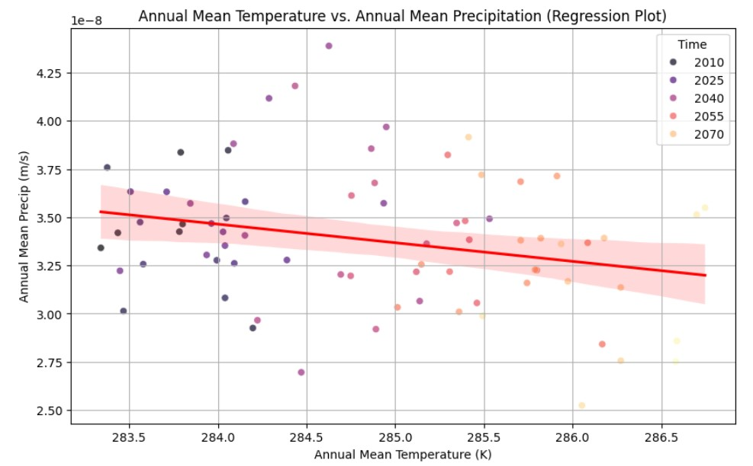
Section 2: Correlation & Statistical Analysis
Temperature vs. Precipitation
Statistical Result: Weak/Negative linear correlation (R=−0.258).
Observation: The regression line remains relatively flat despite significant warming.
Key insight: Rising temperatures alone do not automatically mean more annual mean rainfall.

Slide 8
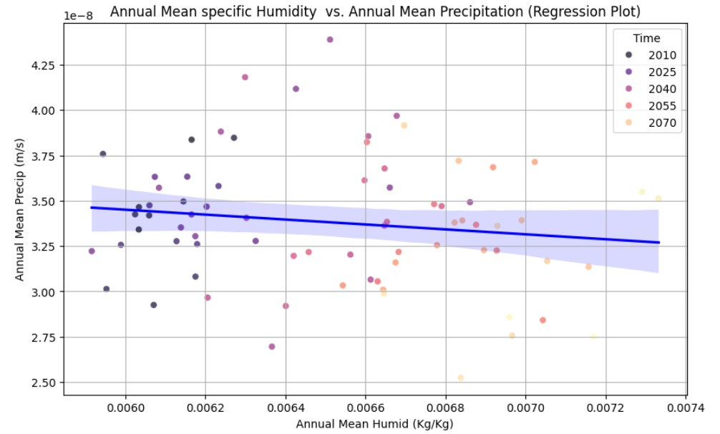
Section 2: Correlation & Statistical Analysis
Humidity vs. Precipitation
Statistical Result: Very weak correlation (R=−0.14).
Observation: Increased water availability in the atmosphere does not result in a steady increase in mean precipitation.
Key Shift: Suggests that moisture is likely released through extreme bursts rather than steady rain.

Slide 9
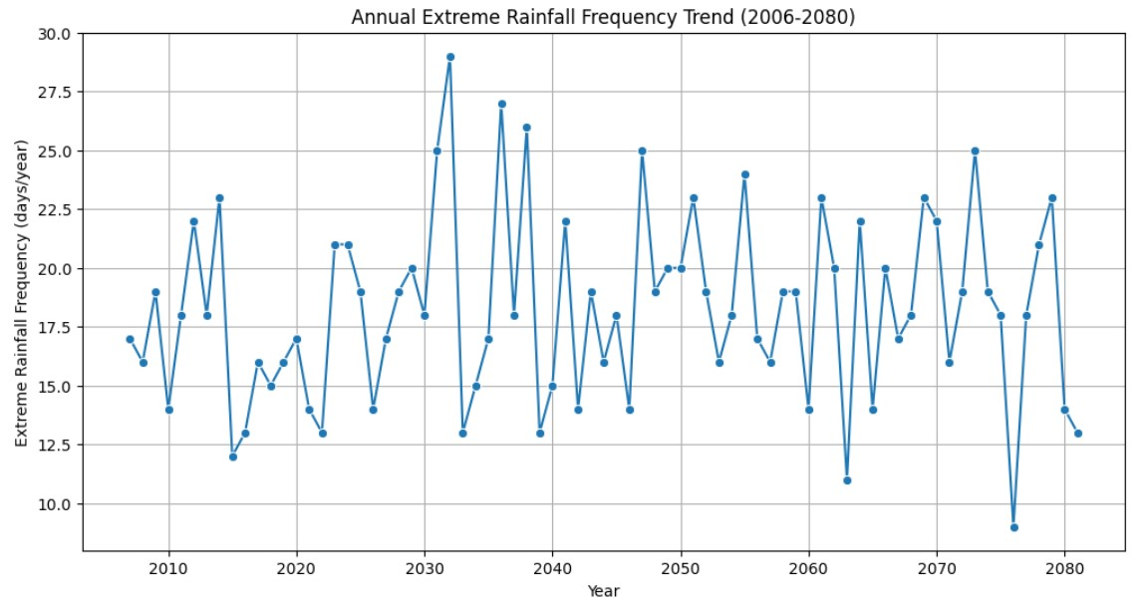
Frequency of extreme precipitation events
Trend assessment: No clear linear upward/downward trend is discernible.
High interannual variability: The number of extreme precipitation days exhibits sharp ups and downs throughout the forecast period.
Critical high-risk period: A highly significant peak emerges in the early to mid 2030s, indicating a much higher frequency than the historical average.

Slide 10
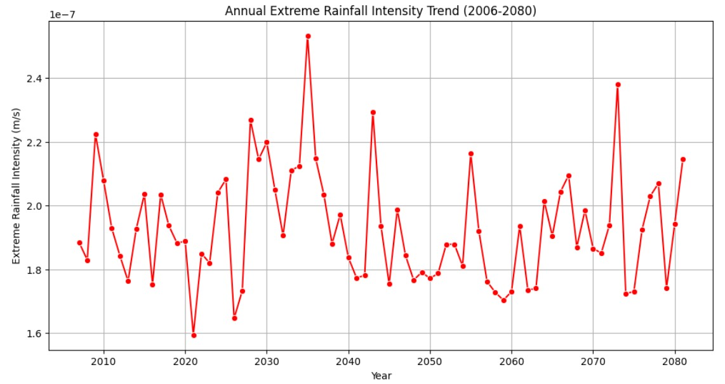
Intensity of extreme precipitation events
Trend assessment: There is no clear continuous intensity increase/decrease over the years.
Outbreak of extreme intensity: Mid 2030s, indicates an extremely prominent peak in precipitation intensity far exceeding the historical and future average baselines.
Implication: This poses a risk to the occurrence of flash flooding.

Slide 11
Conclusion
The study demonstrates that regional warming leads to a clear increase in atmospheric moisture. However, increased moisture does not produce a proportional increase in mean annual precipitation. Instead, rainfall appears to become more variable and more intense during extreme events. The peak in intensity poses a severe risk of flash flooding.
Limitations
I. Both the frequency and intensity of extreme precipitation exhibit sharp
fluctuations, making it difficult to establish a clear long-term linear projection trend.
II. The conclusions are highly dependent on specific projection scenarios for the 2006–2080 period and may not encompass all potential climate change pathways.

Slide 12
Recommendations
To reduce flash flood risk, adaptation strategies should prioritise
I.Flood-resilient infrastructure
Develop 'Sponge City' infrastructure by implementing permeable pavements, green roofs, and constructed wetlands to capture rainwater and mitigate surface runoff pressure.
Improve engineering design standards for all public infrastructure to withstand higher "Extreme Rainfall Intensity" baselines.
II. Improved drainage systems
Upgrade and expand ageing urban drainage networks while introducing real-time monitoring systems to pre-emptively drain scenic lakes or detention basins based on precipitation forecasts, thereby increasing storage capacity
III. Early warning mechanisms
Upgrade ageing drainage networks and implement "Smart Reservoirs" with real-time monitoring to pre-emptively manage water levels.

Slide 13
